Slide 1
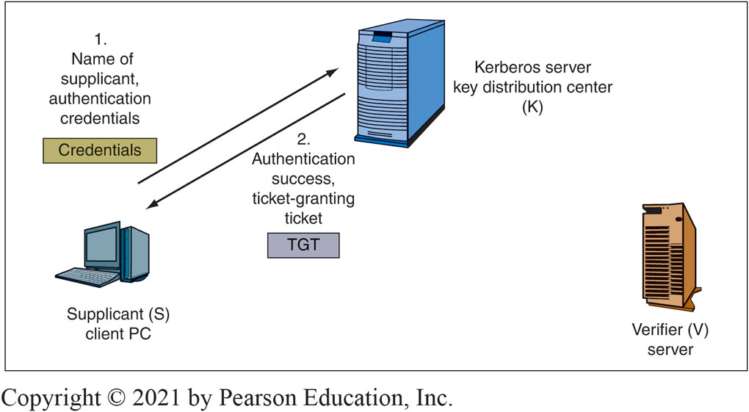
Figure 5-22: Kerberos (Initial authentication)
Kerberos is an authentication and key distribution system.
Notes:
Figure 5-22 shows that when a host wishes to connect to another host, it first logs into a Kerberos server. If it succeeds in logging in, it gets a ticket granting ticket (TGT). This is like getting a wrist bracelet when you enter a concert or sports event. It gets you back in later without having to show your original authentication credentials.

Slide 2
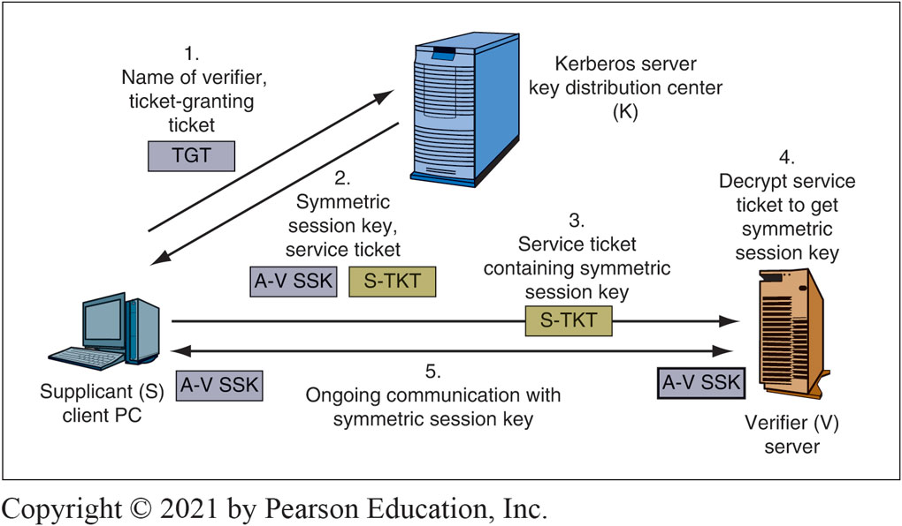
KERBEROS server (keying)

Slide 3
Questions About kerberos
1. What credentials are used at the initial authentication step? (login name, digital certificate, MS-Chap- can these be used?)
2. Do S and V need to be pre-registered with the Kerberos KDS ? (KDS – Key Distribution Centre)
3. Explain the encryption /decryption process at the initial authentication stage
In the diagram, it says that V decrypts …what key will V use to decrypt?
4. Does S authenticate itself to K in initial authentication?
5. Does K authenticate itself to S in initial authentication?

Slide 4
Initial authentication explained
Kerberos V5 is based on the Kerberos authentication system developed at MIT. Under Kerberos, a client (generally either a user or a service) sends a request for a ticket to the Key Distribution Center (KDC). The KDC creates a ticket-granting ticket (TGT) for the client, encrypts it using the client's password as the key, and sends the encrypted TGT back to the client. The client then attempts to decrypt the TGT, using its password. If the client successfully decrypts the TGT (i.e., if the client gave the correct password), it keeps the decrypted TGT, which indicates proof of the client's identity.
The TGT, which expires at a specified time, permits the client to obtain additional tickets, which give permission for specific services. The requesting and granting of these additional tickets is user-transparent.
(https://web.mit.edu/kerberos/krb5-1.5/krb5-1.5.4/doc/krb5-install/What-is-Kerberos-and-How-Does-it-Work_003f.html)
See also https://www.techtarget.com/searchsecurity/definition/Kerberos

Slide 5
An Overview of the Kerberos Protocol Flow
The Kerberos protocol flow involves three secret keys: client/user hash, TGS secret key, and SS secret key. The basic protocol flow steps are as follows:
Initial Client Authentication Request - The protocol flow starts with the client logging in to the domain. In this step, the user asks for the TGT or authentication token from the authentication server (AS) The TGT request is sent to the Kerberos Key Distribution Centre (KDC.)
Verification of Client Credentials - The KDC must verify the user's credentials to send an encrypted session key and TGT. The AS checks for the TGS's and client's availability in the database. If both values are found, the AS generates the secret key. It also creates a session key (SK1) that is encrypted by the user's secret key and a TGT with the client network address, identification (ID), timestamp, lifetime, and SK1. Then, the TGS secret key encrypts the ticket.
Message Decryption - The client uses the client/user hash or secret key to extract the TGT and SK1 and decrypt the message, then generates the authenticator that validates the TGS.
Request for Access Using the TGT - The client then requests a ticket from the SS by sending the authenticator and the extracted TGT to the TGS.
https://www.fortinet.com/resources/cyberglossary/kerberos-authentication

Slide 6
An Overview of the Kerberos Protocol Flow
5. Creation of Ticket for the File Server - The TGS secret key is used to decrypt the TGT from the client and extract the SK1. TGS also decrypts the authenticator and verifies that it matches the network address and the client ID, and ensures that the TGT is not expired by using an extracted timestamp. If all checks are done successfully, the KDC will generate a shared service session key (SK2) for the target server and the client. The KDC then creates a service ticket with the client network address, ID, timestamp, and SK2. This ticket will be encrypted with the server's secret key, and the client will receive the service ticket and SK2, which will be encrypted with the SK1.
6. Authentication Using the File Ticket - The client then uses the file ticket to authenticate by decrypting the message with SK1 and extracting SK2. Doing so will generate another authenticator, encrypted with SK2, that includes the client ID, network address, and timestamp. The client then sends a service ticket along with the new authenticator to the target server.
7. Decryption and Authentication of the Target Server - As the final step in the Kerberos protocol, the target server then decrypts the service ticket and extracts the SK2 using the server's secret key. SK2 decrypts the authenticator, and checks are performed to ensure that the client network address and ID from the service ticket and the authenticator match. After all checks are made and met, the client will receive a message from the server stating that the server and the client have authenticated each other.
https://www.fortinet.com/resources/cyberglossary/kerberos-authentication

